Slide 1

HIRE-HORIZON: A Comprehensive Job Application Platform
Ashwin Ashok Yadav
4th Semester
Guide: Honey Ma'am

Slide 2

Introduction: Bridging the Gap
HIRE-HORIZON streamlines job searching. It connects job seekers and employers. The platform addresses inefficiencies.
Purpose
Problem
Create a user-friendly job application platform.
Inefficient job searching and application processes.
Overview
A comprehensive solution for job seekers and employers.

Slide 3
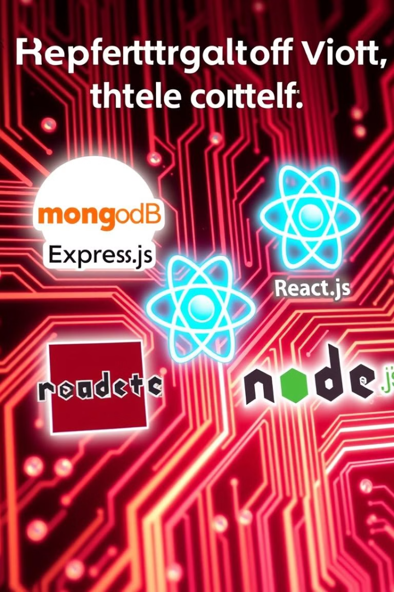
Technology Stack: MERN Powerhouse
HIRE-HORIZON is built on the MERN stack.
MongoDB
Database solution.
Express.js
Backend framework.
React.js
Frontend library.
Node.js
Runtime environment.
Other technologies include JWT, Axios, CSS, and Bootstrap.

Slide 4
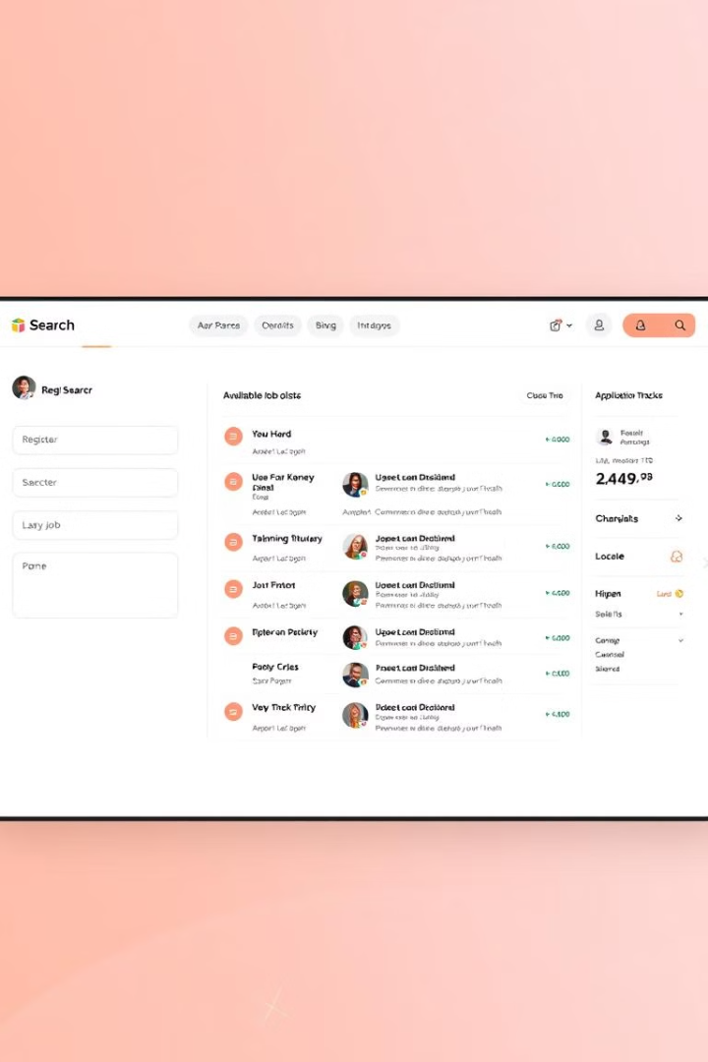




Key Features: Empowering Users
The platform offers a range of features for job seekers and admins.
Registration
Job Listings
Applications
Admin Panel
Admins can update user statuses.

Slide 5
System Analysis: Evolution
The new system improves upon existing methods.
Current System
Proposed System
Manual processes
Automated workflows
Inefficient
Efficient
Time-consuming
User-friendly

Slide 6
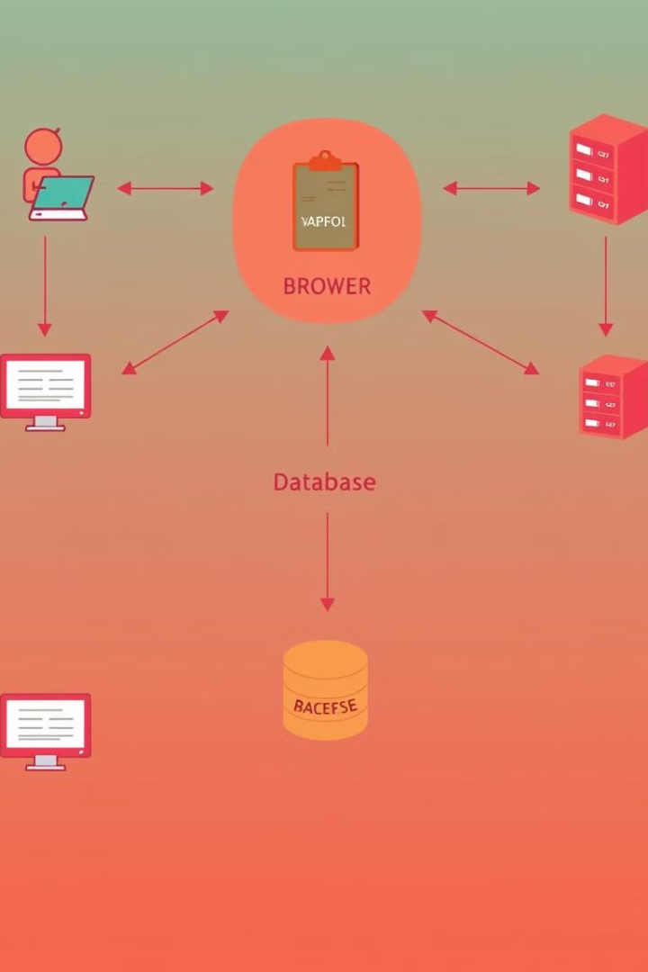

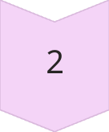
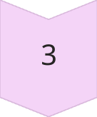

Architecture Diagram: User Interactions
The architecture visualizes data flow and components.
User
Interacts with front end.
Front End
React.js interface.
Backend
Express.js server.
Database
MongoDB storage.

Slide 7



Data Flow Diagram (DFD)
The DFD illustrates data exchange between entities.
2
Admin
1
Job Seeker
System
3
Level-1 DFD showcases major processes and data stores.

Slide 8
ER Diagram: Data Relationships
The ER diagram models data entities and relationships.
User
1
Attributes.
Job
2
Details.
Application
3
Status.
Relationships link users, jobs, and applications.

Slide 9



Conclusion and Future Scope
HIRE-HORIZON offers efficient job searching.
1
Scalability
2
New features
3
Key learnings
Future enhancements include AI-powered matching and advanced analytics.

